Slide 1
Better Health at Your Fingertips:
A Revolutionary RAG Chatbot to Boost Patient and Doctor Success.
Lindsay Zhang
Notes:
I'll begin with a brief PowerPoint presentation to provide an overview of the key components of the project. This will help set the context for the following live demo

Slide 2
1
AWS Setup
2
Dataset Integration
Contents
3
Streamlit Chatbot
4
Data Desensitization

Slide 3

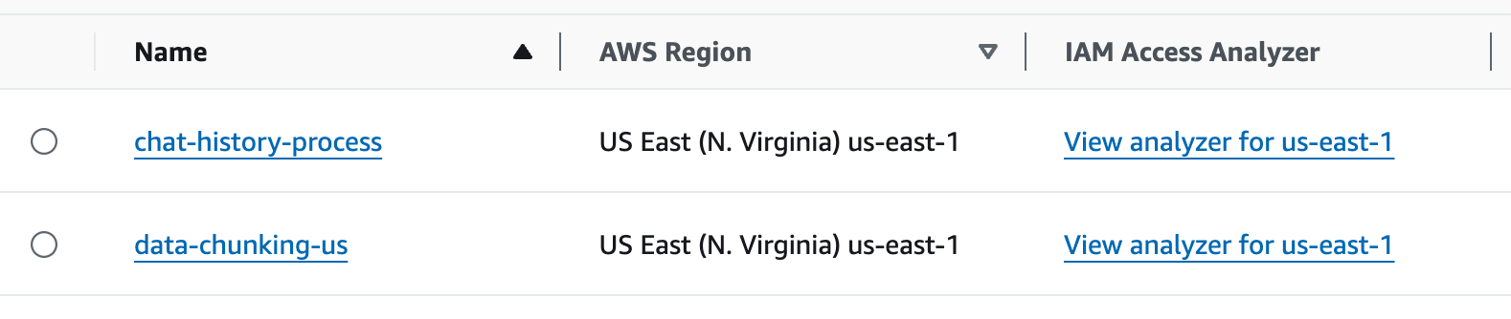
AWS S3

Slide 4
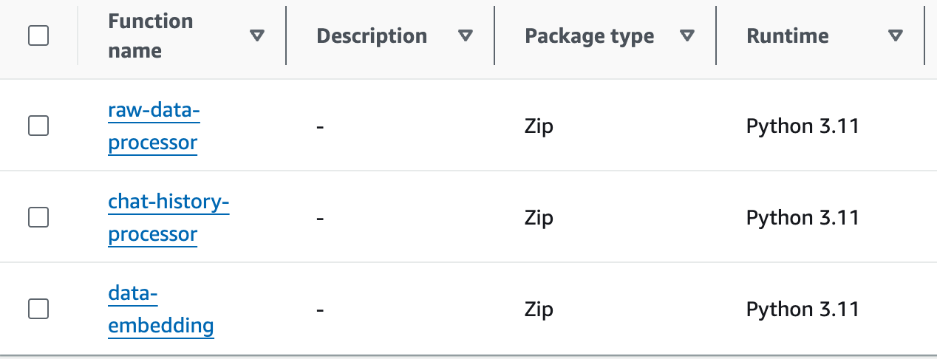
AWS Lambda

Slide 5


Sources
MedlinePlus
DrugBank
Uniprot
Range of article IDs
Total files uploaded: 852
Range of IDs
Total files uploaded: 936
Range of IDs
Total files uploaded: 977

Slide 6
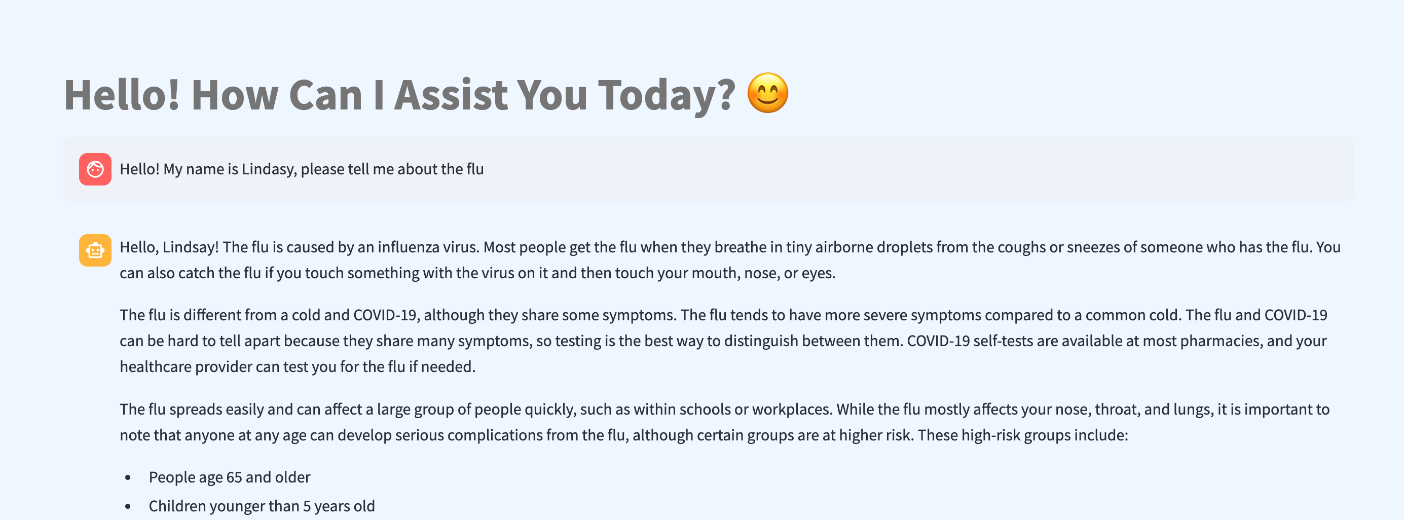
Screenshot
The core of this application is a retrieval system powered by Pinecone and the VoyageAI model.
Utilizes LangChain’s built-in components to handle conversation history and context, such as use create_history_aware_retriever to incorporate the conversation history into the retrieval process, making the responses more contextually aware.

Slide 7
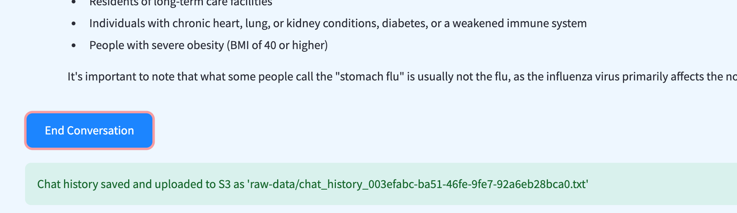
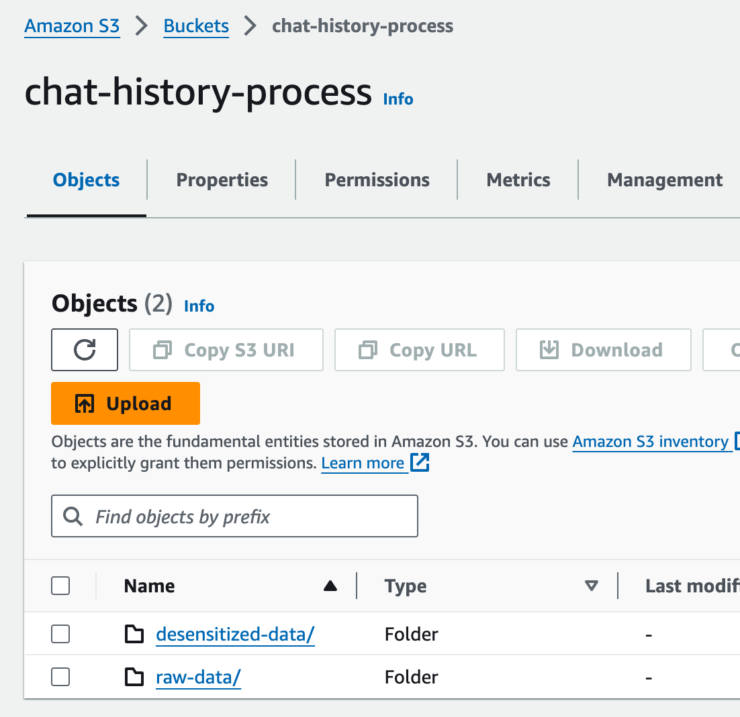
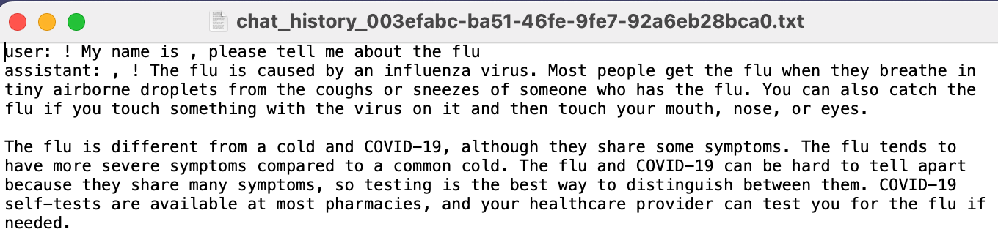
AWS S3

Slide 8
THANK YOU!
😊
Notes:
Thanks people

